Slide 1
Colonial Resistance and Rebellion
What were the conflicts between England and the American colonies?
Why did the colonists finally declare their independence?

Slide 2
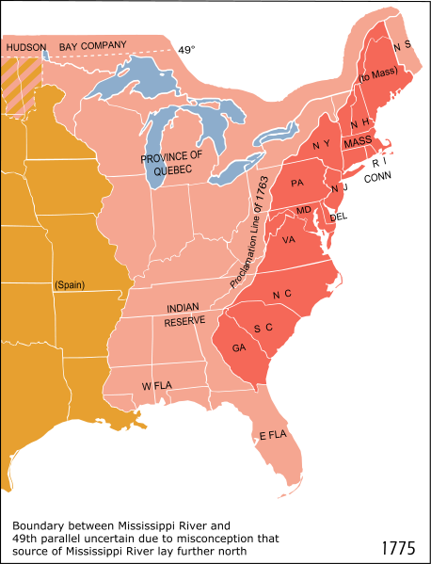
Factors from French and Indian War
Proclamation of 1763—line along the Appalachians which the colonists were not allowed to cross.
Hoping to avoid expensive conflicts with Indians

Slide 3
The colonists kept steaming beyond the proclamation line anyway.
Colonist believed British govt. didn’t care about their needs.
French and Indian War cost a lot of $--Britain needed some way to offset those costs

Slide 4
Sugar Act--1764
British had cracked down on MA during French and Indian war.
Tried to get rid of smuggling
Searched people possessions without warrants

Slide 5

The Stamp Act

Slide 6
March 1765—put a tax on all documents and printed items (wills, newspapers, playing cards, etc)
May 1765-colonists united to defy the law
Sons of Liberty—secret resistance group
“No taxation without representation”
Organized boycotts
March 1766—Stamp Act repealed

Slide 7
Townshend Act 1767
Placed tax on tea
Goods imported into the colonies
Colonists mount boycotts again

Slide 8
British soldiers are located in MA. The colonists have to “quarter” them or give them room and board.
They are not paid back for this
Soldiers also take jobs away from colonists

Slide 9
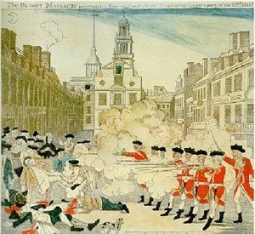
Boston Massacre 1770

Slide 10
March 1770—a mob of colonists gather in front of the Boston Customs House and taunt British soldiers
Some rock throwing and name calling
British soldiers fired onto the colonists killing 5 colonists

Slide 11
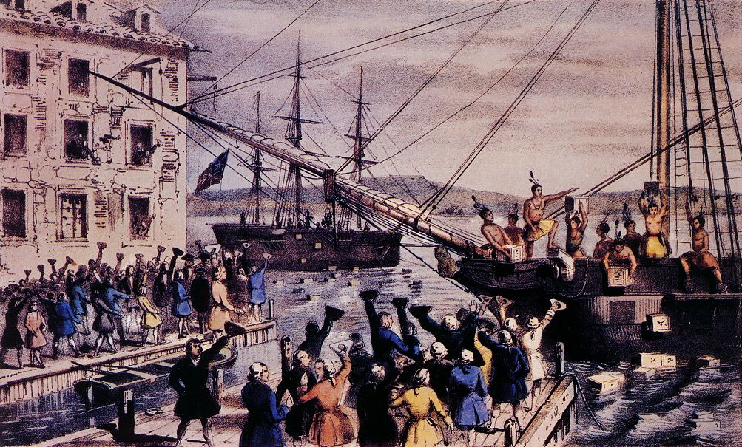
The Boston Tea Party--1773

Slide 12
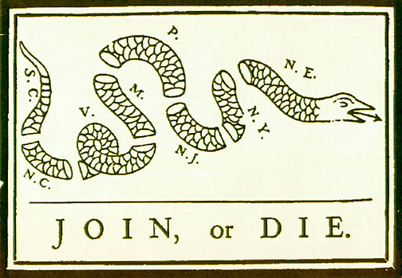
The Intolerable Acts
1774—acts that shut down Boston harbor
Boston placed under martial law

Slide 13
First Continental Congress
1774—56 delegates met in Philadelphia and drew up declaration of colonial rights.
Basically defended the colonists’ right to run their own affairs
If British used force against colonists the colonies would fight back

