Slide 1
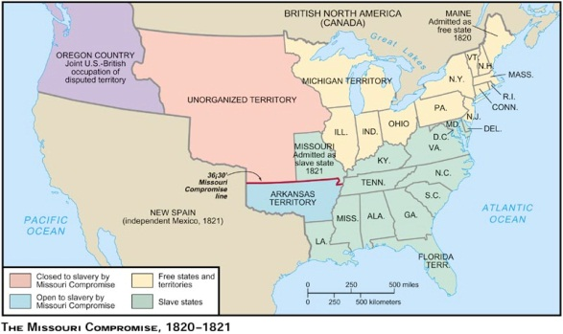
Missouri Compromise 1820

Slide 2
Impact of Westward Expansion
Can the government control the expansion of slavery?
Property constitutionally protected
What about states’ rights?
Terrorties are not yet states
Upsetting the balance between free and slave states

Slide 3
1st compromise dealing with slavery extending westward.
Missouri wanted to enter as a slave state
Would have upset the balance between free and slave states—in the Senate
Missouri comes in as slave state
Maine comes in as a free state
36’ 30 line established—North of this line free, south of this line slave

Slide 4
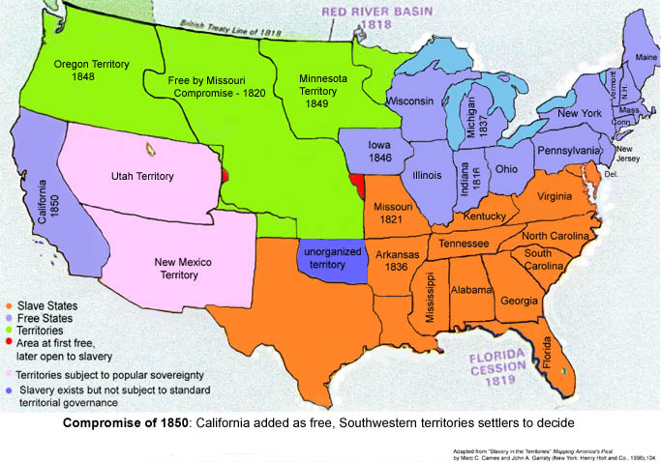
Mexican-American War 1848

Slide 5
Events that Contribute to the Civil War
1850-1860

Slide 6
Compromise of 1850
California free statee
New Mexico and Utah—popular sovereignty –citizens can vote on slave issue
D.C. slave trade banned
Could still own slaves in D.C.
Fugitive Slave Law--

Slide 7
1852-—publication of Uncle Tom’s Cabin --Harriet Beecher Stowe
Why significant---for the 1st time many Northerners were exposed to the horrors of slavery.
It was a major bestseller—sold 300,000 copies in just 1 year
Southerners HATED it. Said the book was all lies.

Slide 8
The Kansas-Nebraska Act—1854
Stephan Douglas introduced a bill in Congress to organize the Kansas and Nebraska territories into separate states.
His bill allowed for popular sovereignty on the issue of slavery in these new territories.

Slide 9
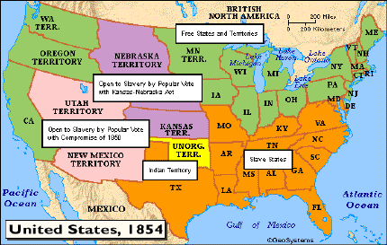

Slide 10
This legislation angers Northerners because it opens the door to slavery above the 36 degree 30’ line.
Violence soon erupted in Kansas—as anti-slavery zealots and pro-slavery zealots poured into Kansas to influence the voting.
“Border Ruffians” –pro-slavery guys from Missouri attack anti-slavery people and vote illegally in the Kansas elections
By 1856-2 territorial govts are in Kansas—Anti-Slavery and Pro-Slavery

Slide 11
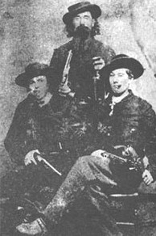

Slide 12
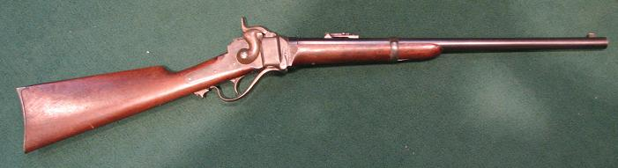
Beecher’s Bibles
Given to Antislavery People who were going to Kansas

Slide 13
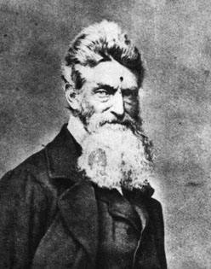
500 Border Ruffians attacked the Anti-Slavery town of Lawrence, Kansas
Abolitionist John Brown sought revenge by hacking 6 proslavery men to death at the Proslavery town of Pottowattamie Creek, Kansas

Slide 14
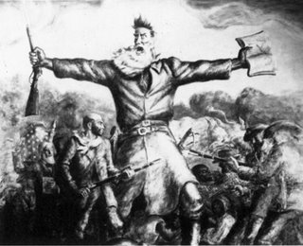
Terrorist or Martyr

Slide 15
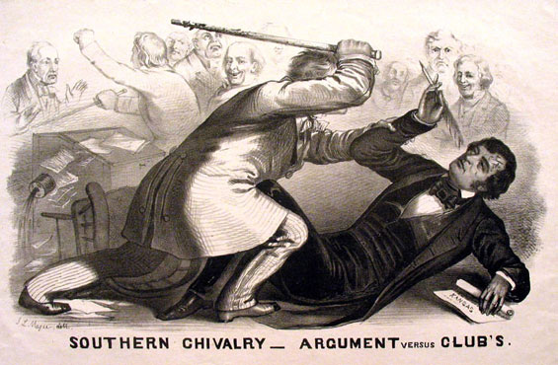
Violence in the Senate--1856
Brooks beats Sen. Sumner with a cane over an insult to his uncle.

Slide 16
Politics of the 1850s
The issue of slavery and the conflicts throughout the 1850s split the political parties—Whigs and Democrats.
Think about the difficulty of having a political party that appeals to both Northerners and Southerners.

Slide 17
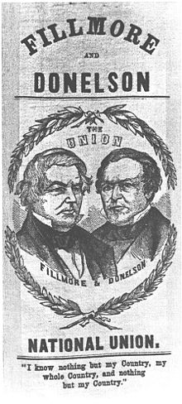
New Political Parties Formed
Know-Nothing Party (American Party)
Anti-Immigrant
Had to live in U.S. 25 years before
Citizenship was given
Anti-Catholic
Pro-Slavery

Slide 18
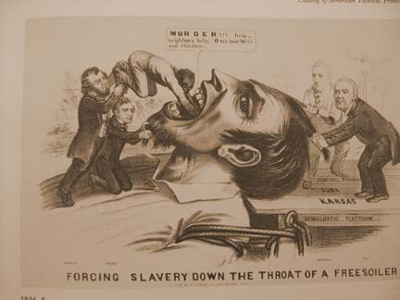
Free-Soil Party—
Opposed the spread of slavery
Why? Believed the spread of slavery would force white workers to compete with slaves for jobs.

Slide 19
1854-Republican Party was formed.
Party Platform
Oppose the spread of slavery into western territories.
Opposed the Kansas-Nebraska Act
Wanted to reinstate the Missouri Compromise

Slide 20
Election of 1856-James Buchanan wanted the Supreme Court to decide once and for all on the issue of slavery
1857—Dred Scott Decision
Dred Scott was a slave whose owner took him from the slave state of Missouri to the free state of Illinois and free territory of WI.
Scott appealed to the Supreme Court for his freedom on the grounds that living in a free state had made him a free man.

Slide 21
Supreme Court was composed mostly of Southerners
Ruled against Dred Scott
Reasons
Lacked any standing to sue because he was not nor could he ever be a citizen.
Free territory did not make a slave free
5th Amendment protected property—for territories to exclude slavery would be to deprive slaveholders of their property.

Slide 22
Southerners felt like they had won the battle
Believe the ruling not only permitted the extension of slavery but guaranteed it.
Northerners were outraged by the decision—proved to them the “slaveocracy” was real.
This decision would open the door to slavery everywhere in the country
Would void the Northwest Ordinance, and Missouri Compromise

Slide 23
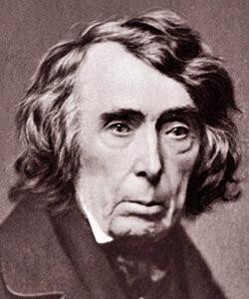
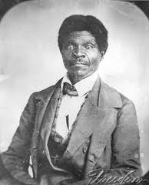

Slide 24
Lincoln-Douglas Debates 1858
Grab an American Anthem textbook.
Turn to page 119—Lincoln’s Path to the Presidency
Read from there to page 121. Stop at the South Secedes.
1. Answer in your notebooks—page 120 Skills Focus Reading Like a historian

Slide 25
2. Answer in your notebook the reading check on page 121—What were Lincoln’s beliefs on regulating slavery?
How did Lincoln’s background effect his views on slavery?
Was Lincoln an abolitionist? Explain.

