Slide 1
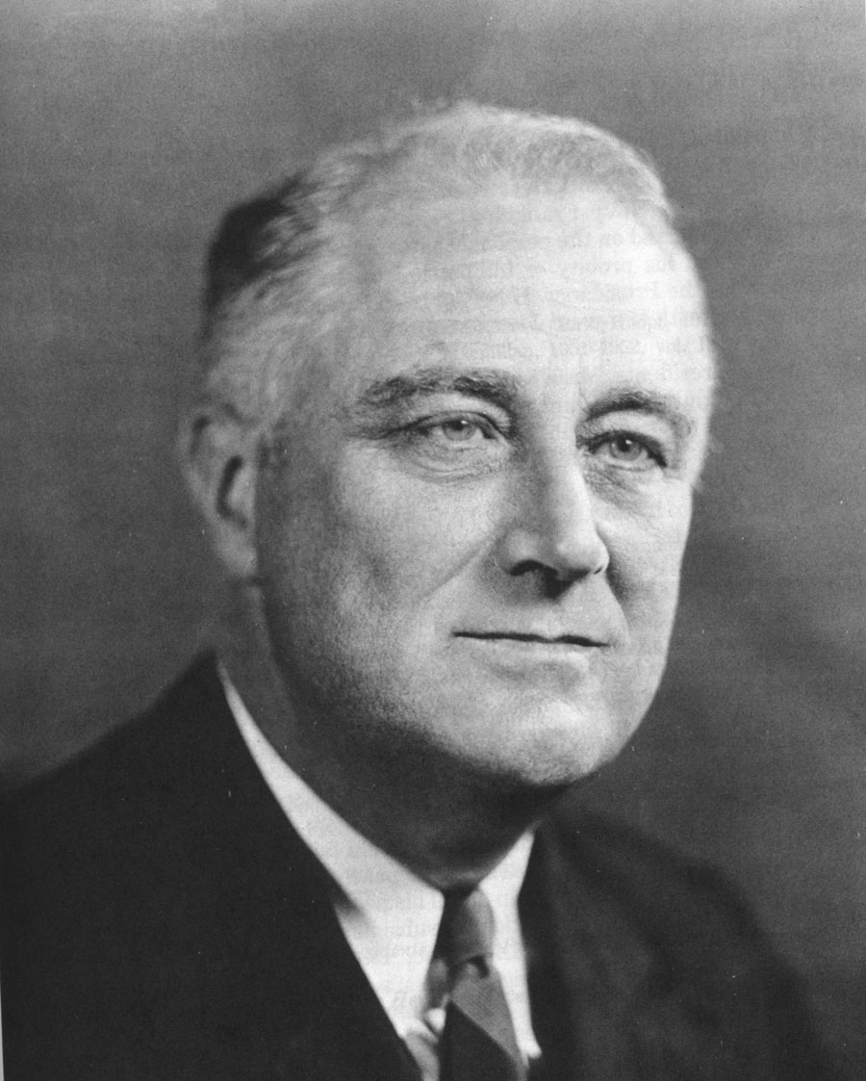
Franklin D. Roosevelt
The New Deal

Slide 2
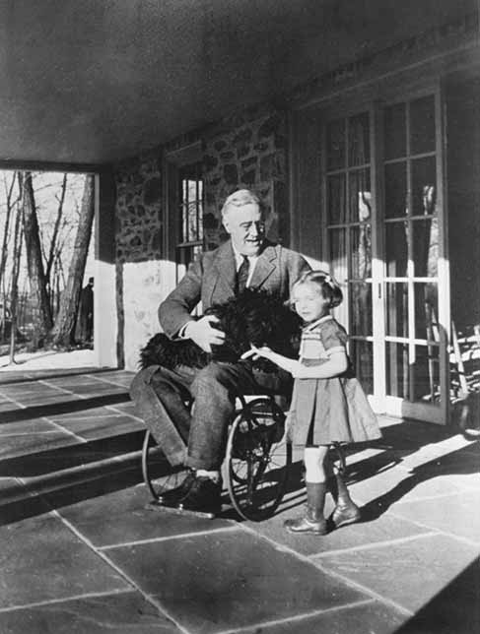
From a wealthy NY family.
TR was his 6th cousin
His wife Eleanor was TR’s niece
Served as state senator from NY
Was Assistant Sec of the Navy during WWI

Slide 3
At the age of 39 he contracted polio.
This caused him to be partially paralyzed.
Took him 7 years to recover.
Most people thought his career was over.
Becomes governor of NY (serves 2 terms)
Runs as the Democratic candidate in the 1932 election
Democrats swept the election, winning a majority of House and Senate seats.

Slide 4
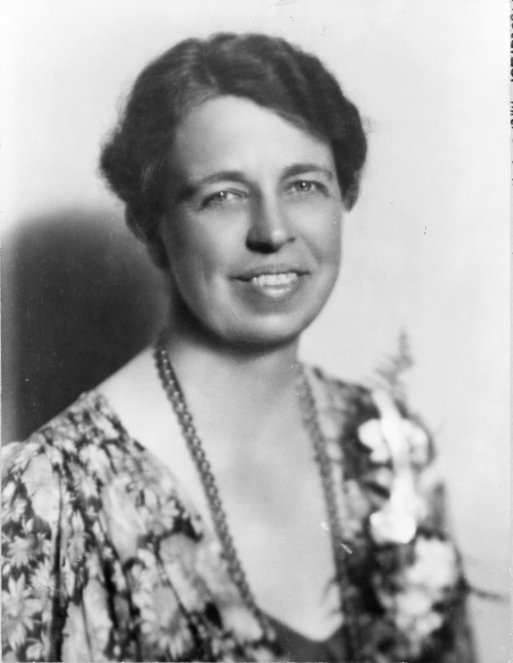
Eleanor has very popular too. She spurred FDR on to reforms.
She served as his legs. She traveled the country talking with people and came back and reported what she saw to him.
She also pushed him in the area of Civil Rights and rights for the poor.

Slide 5
After he is elected there is a 4 month waiting period before he can be inaugurated.
20th Amendment is passed due to this—moves the inauguration to Jan.
“The only thing we have to fear is fear is fear itself.”
In the 4 month period he convenes a brain trust to help him develop policies
This is the NEW DEAL!

Slide 6
The 1st 100 Days –15 major pieces of legislation are passed to deal with the Great Depression.
Communication skills— Fireside Chats– used the radio to calmly explain to the American people exactly what he was going to do.
This smoothed their fears
21st Amendment—Repealed the 18th Amendment—reason: so alcohol could be taxed-provide funds for the New Deal

Slide 7
Regulation
Glass-Steagall Act--Banking Reforms—Bank Holiday—shut the banks down to inspect them. Those that opened back up were safe.
Made people trust the banks again. Could take their money out of the mattress and start depositing it again.
Federal Deposit Insurance Corporation (FDIC)—insures deposits

Slide 8
The Federal Securities Act-Business have to publish info about their companies
Securities and Exchange Commission- (SEC)—regulates the stock market –prevents insider trading.

Slide 9
Relieve Poverty
AAA—Agricultural Adjustment Act—for farmers—govt paid farmers to not grow crops or livestock—the hope was that the less food in production would drive up prices
Downside--?

Slide 10
Work Projects—govt paid citizens to do work for the govt.
CCC—Civilian Conservation Corps—for men 18-25—focused on Conservation—building fire trails, fire towers, replanting trees, controlling soil erosion—working in national parks
Paid $30/month—had to send $25 home.
Also had a chance to take classes.

Slide 11
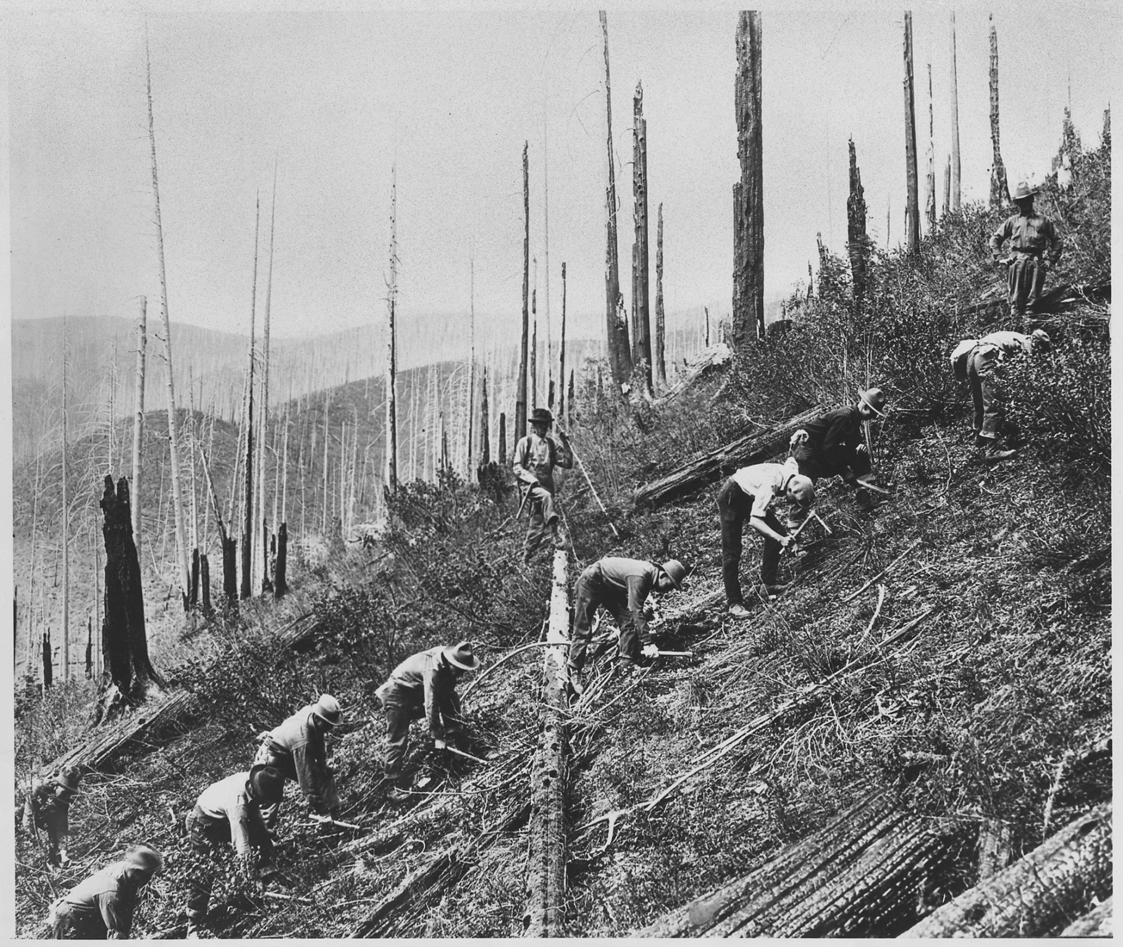

Slide 12
TVA (Tennessee Valley Authority)—project to provide a series of dams on the Tennessee River and its tributaries.

Slide 13
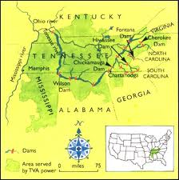
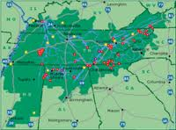
It provided flood control, hydroelectric power (electricity for the 1st time to this area) and provided 1,000s of jobs.

Slide 14
National Industrial Recovery Act (NIRA)—provided money to states to create jobs building schools.
Critics called it them “make work” projects & a waste of $.
Built 40,000 schools, paid for 50,000 teachers & built 500,000 miles of roads

Slide 15
NIRA—established codes of fair practice for industries.
Created the National Recovery Administration (NRA) which set prices for goods and quality standards

Slide 16
Federal Emergency Relief Act (FERA)—gave $ directly to people.

