Slide 1
Hoover’s Response
Main Idea:
President Hoover’s conservative response to the Depression drew criticism from many Americans.

Slide 2
Hoover’s response to the Depression reflects his upbringing and his beliefs.
His was a poor orphaned who worked hard and became a millionaire.
He believed that depressions were a normal part of the business cycle. We had always had ups and downs in the economy.
Belief was to do nothing and let the economy fix itself—Laissez-faire

Slide 3
Hoover believed in “rugged individualism”—the idea that people should succeed through their own efforts.
They should take care of themselves and their family.
Government handouts causes people to lose their work ethic.
Lose their self-respect and a desire for work.
Believed local charities and churches should provide relief—NOT THE GOVERNMENT.

Slide 4
He did some things—convened a group of business leaders, union leaders and government officials.
The problem was that this depression was worse than anything ever experienced before.
One project that Hoover did start was the Hoover (Boulder Dam). This was a huge construction project that employed thousands of Americans

Slide 5
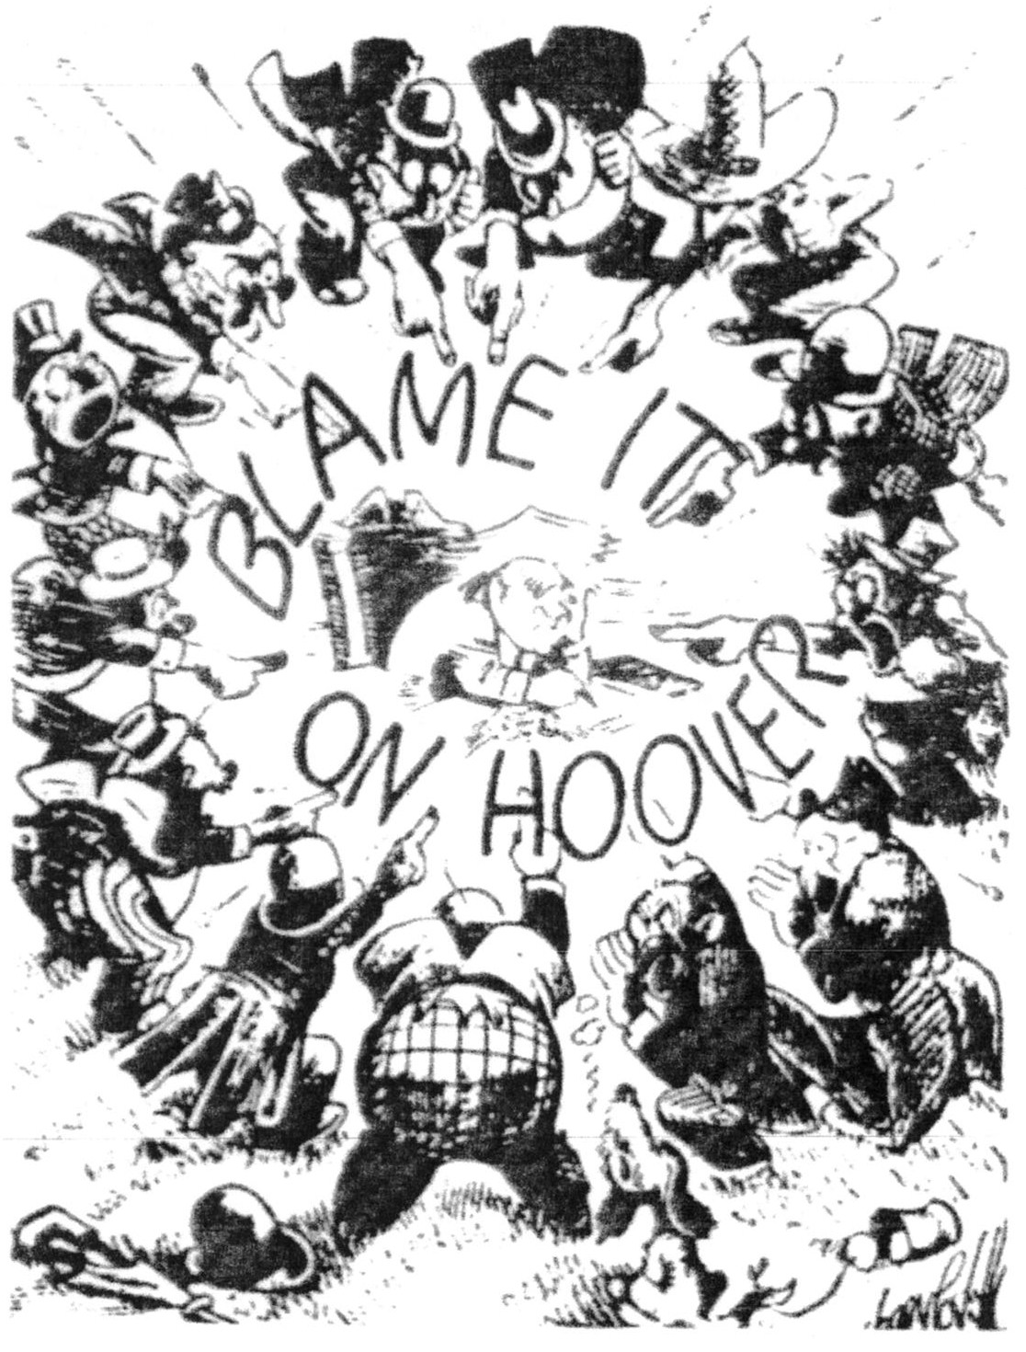

Slide 6
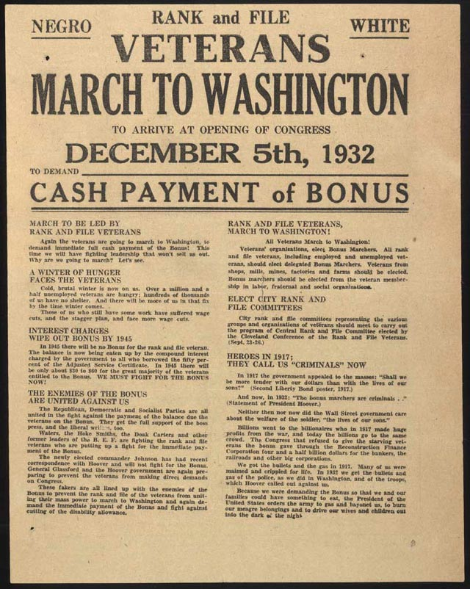

Slide 7
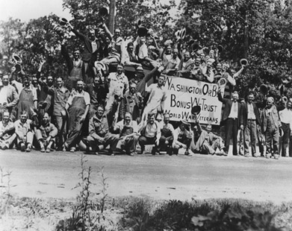
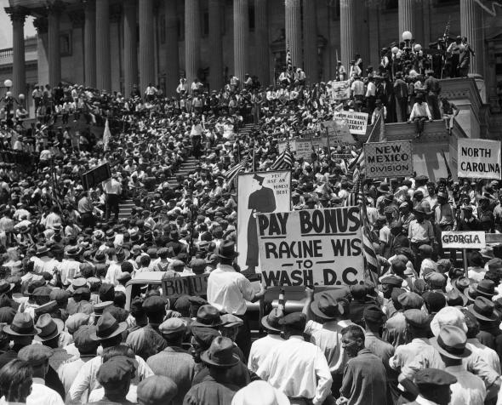

Slide 8
Bonus Army—group of unemployed WW I veterans.
Been promised a bonus for their service in the War to get it in 1945.
Bill was proposed to give them their bonus early $500/soldier
Summer of 1932—they converged on D.C. to show support for the bill
It failed to pass
Stayed around
Afraid it would become violent

Slide 9
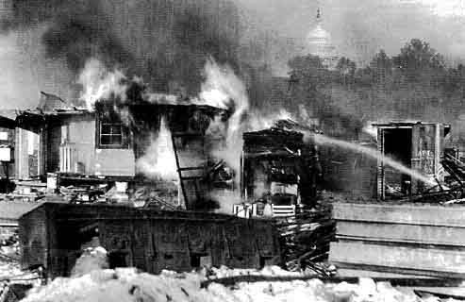
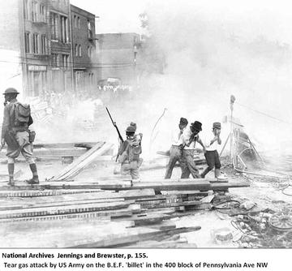

Slide 10
Gen Douglas MacArthur ordered to force the vets to leave.
MacArthur sends in 1,000 troops with tanks and tear gas.
“ The 12th infantry was in full battle dress. Each had a gas mask and his belt full of tear gas bombs…At orders, they brought their bayonets at thrust and moved in. The bayonets were used to jab people, to make them move. Soon, almost everybody disappeared from view, because tear gas bombs exploded. The entire block was covered with tear gas. Flames were coming up, where the soldiers set fire to the buildings to drive these people out…Through the whole afternoon, they took one camp after another.”

Slide 11
1,000 people were gassed. An 11-month old baby died, an 8-year-old boy was partially blinded. Two people were shot and may injured.
The American public were outraged.
This was close to election time.
This hurts Hoover big time for the upcoming election.

