Slide 1
Essential Questions
What was the labor system that developed in the Virginia Colony (Jamestown)?
What did this system eventually change to?

Slide 2
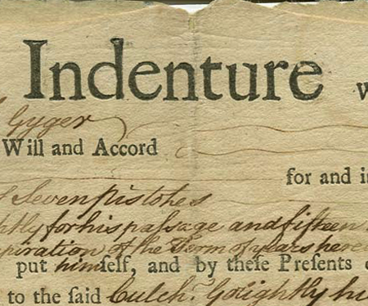
Indentured Servants

Slide 3
How it worked
Master paid passage to Virginia
Provided a place to live and food
Provided clothes.
Indentured Servant
Worked 4-7 years
After term of contract received “freedom dues”--$, supplies, and land

Slide 4
Some former Indentured Servants eventually got their own Indentured Servants.
These indentured servants could be black or white. It didn’t matter. They were treated the same.

Slide 5
But the Indentured Servant system begins to lose its popularity. Why?
Conditions in England begin to improve.
VA begins to run out of land (don’t have that incentive anymore)
People eventually find out how bad the treatment was.

Slide 6
Still a huge demand for workers
So what can they do?
Enslave the Indians? Why won’t that work?
Turn to slavery—make it based on race not religion, and make it permanent (no giving freedom land)
Always have a ready workforce

Slide 7
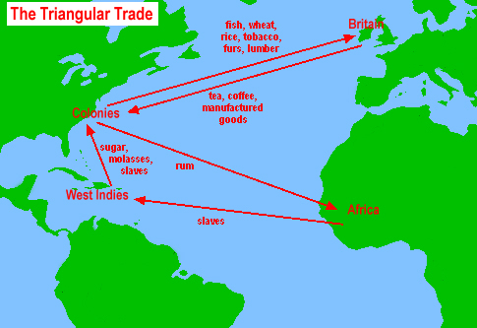

Slide 8
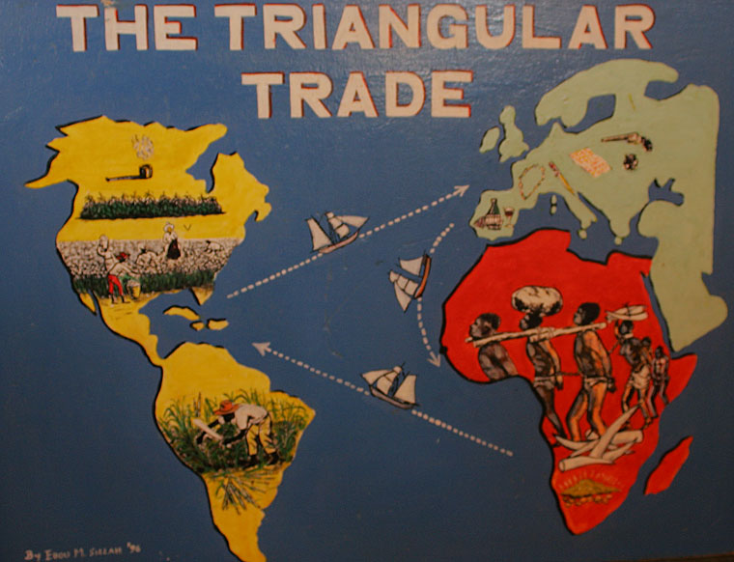

Slide 9
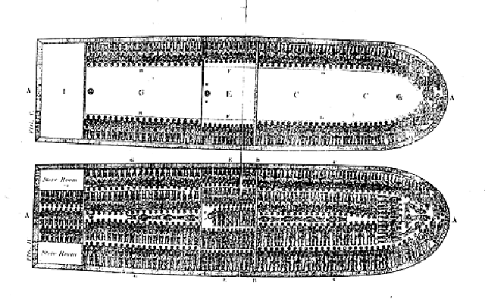
Middle Passage
The part of the triangular trade in which Africans are sent to the New World.

Slide 10
