Slide 1
The Nation’s Sick Economy
Causes of the Great Depression

Slide 2
Learning Target:
I can explain the intersecting causes of the late 1920s economic collapse.

Slide 3
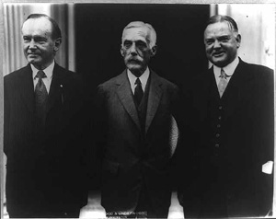
6 Causes of the Great Depression
Republican Economic Policies— “Trickle-down economics”- Tax cuts for the wealthy and businesses they in turn would invest in the economy.
Raised taxes on middle class and cut spending

Slide 4
Wealth did not trickle-down—companies invested in technology that cut jobs
Owners kept workers pay low
Hawley-Smoot Tariff Act—tax on imported goods—European nations (in retaliation) placed a tariff on American goods. International trade came to a standstill.

Slide 5
2. Stock Speculation
Throughout the 20s people bought stocks. This is not normally a problem. But they were engaging in speculation—buying stocks with the hopes of a quick profit.
Buying on the Margin—paying a small % of a stock’s price as a down payment & borrowing the rest.

Slide 6
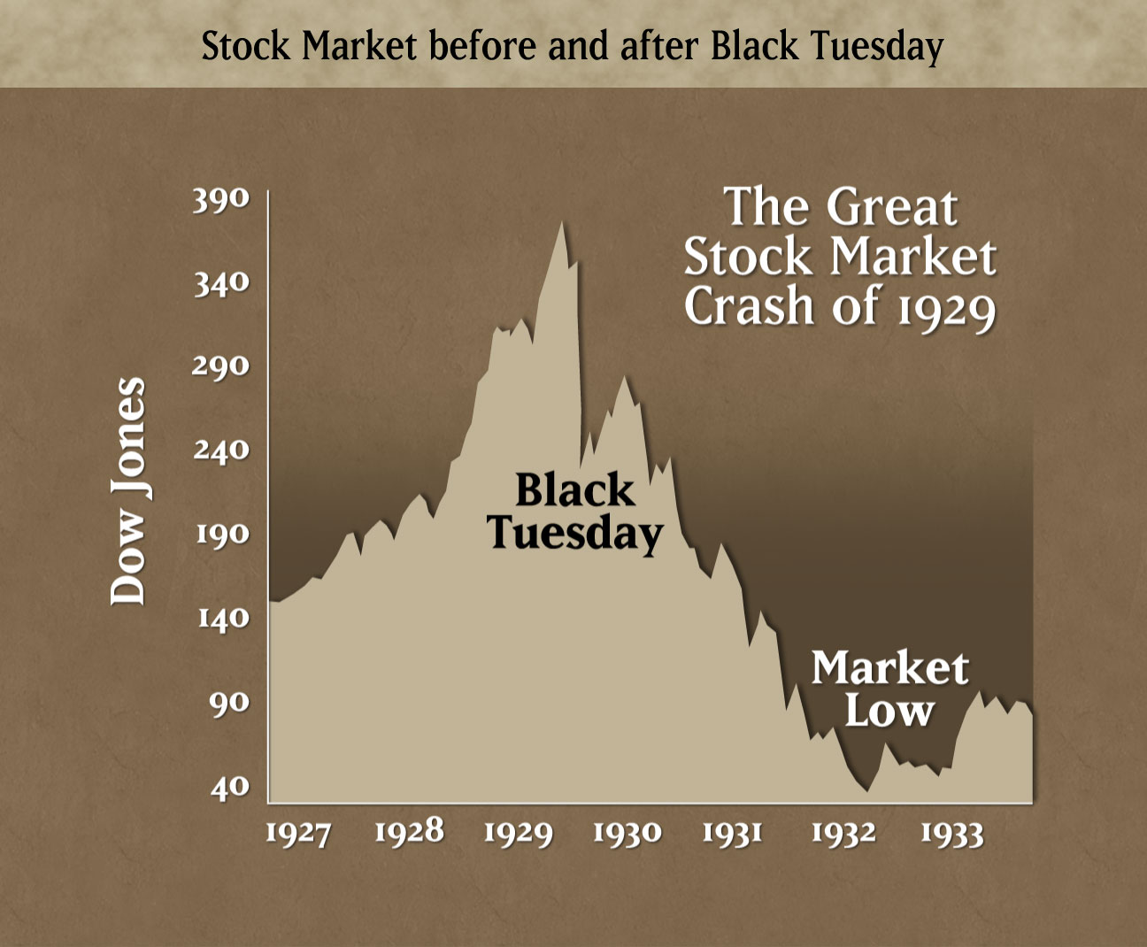
3. Stock Market Crash

Slide 7
In 1929 many investors began selling their stocks
As investors began withdrawing from the market, stock prices started to fall.
By Oct 1929 stock prices bottomed out—Black Tuesday—in a few hours people lost fortunes.
Ex. Someone who had made $22 million in one day, lost $15 mill on Black Tuesday.

Slide 8
4. Unregulated Banks
Stock market crash triggered a collapse of the banking industry
Easy credit—Bankers had also invested in the stock market with client’s $
Run on the Banks-people began to panic and removed their money from the banks
Most couldn’t get their $ because the banks had speculated in the stock market.
Millions of people lost all their savings

Slide 9
5. Decline in Farming
Farmers had been experiencing the Depression since 1919.
Farmers had borrowed money for new machines and more land.
As Depression hit they couldn’t repay loans
Farms were foreclosed on
DUST BOWL hits

Slide 10
6. Unequal Distribution of Wealth
Gap between Rich and Poor—rich got richer and the poor got poorer
This hurts the economy

Slide 11
Depression Indicators
Get a textbook.
Turn to page 470.
Examine the graphs
Answer the Skillbuilder 1 & 2

Slide 12
Depression Indicators
Get a textbook.
Turn to page 470.
Examine the graphs
Answer the Skillbuilder 1 & 2

